Slide 1
Deep Learning from Scratch
Theory + Practical

Slide 2
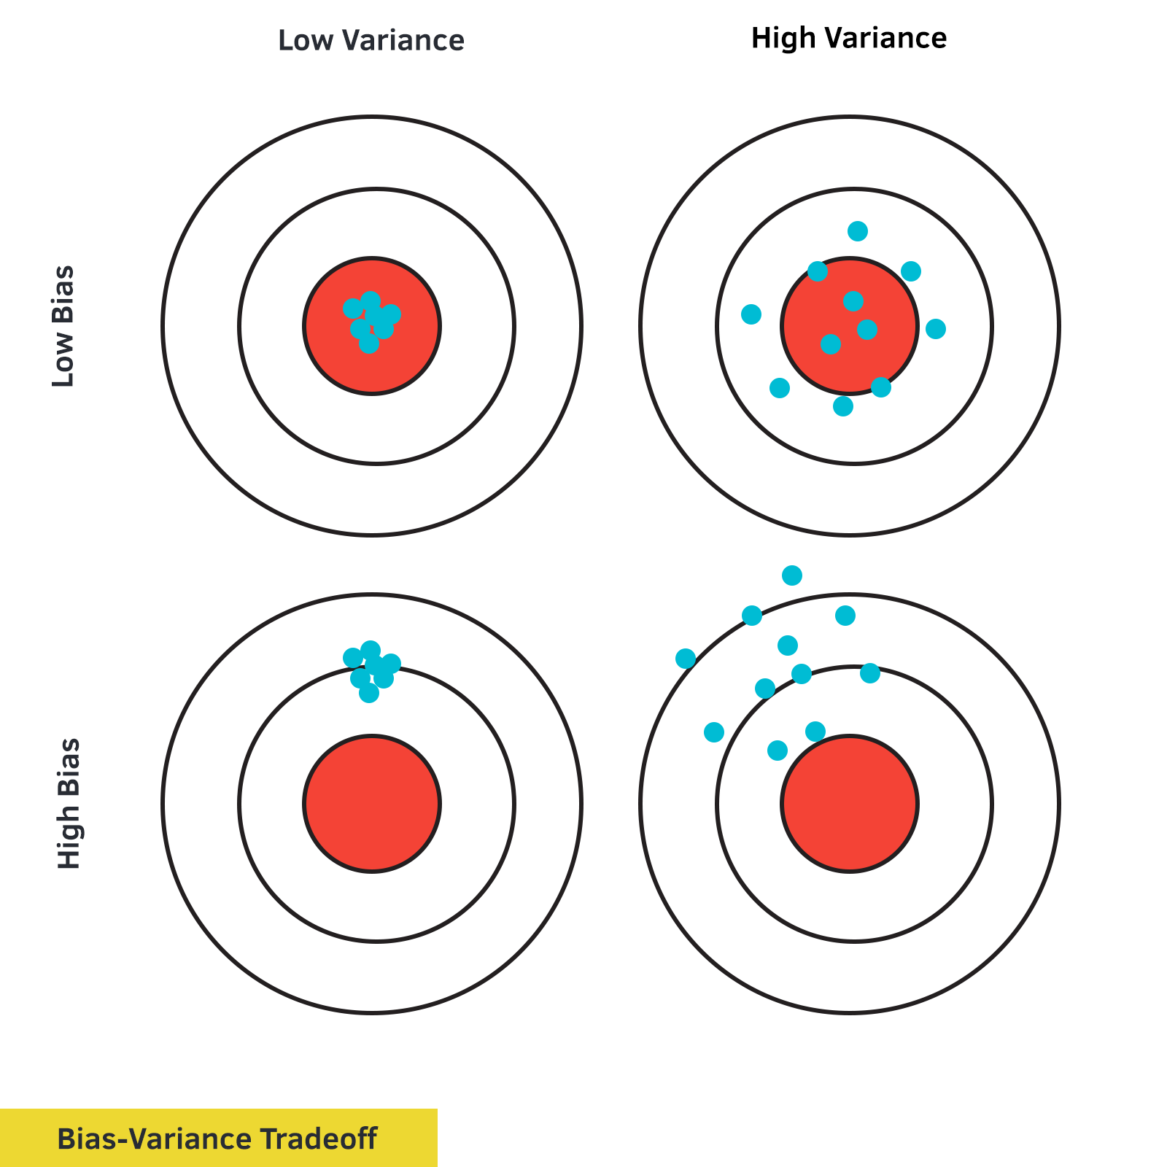

Slide 3
To Handle Overfitting Problem
Bias and Variance Problem (tradeoff)
irreducible Error
Regularization (L1 Ridge Regression , L2 Lasso Regression
Drop out Method (Regularization)

Slide 4
What is Bias and Variance

Slide 5
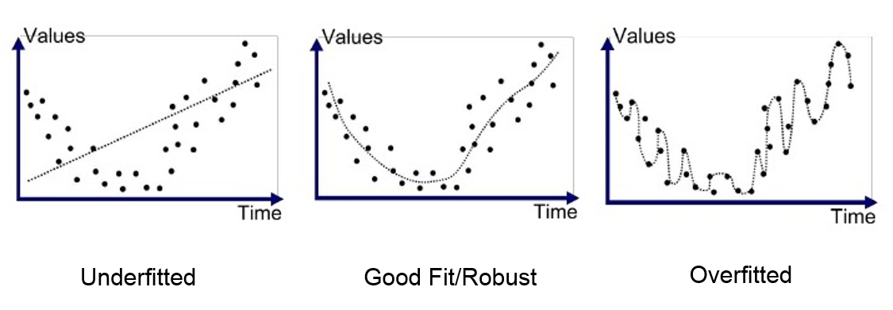
Underfitting and Overfitting (Bias and Variance)

Slide 6
So, What will be the best model
Low Bias, Low Variance

Slide 7
So, what about the irreducible Error, actually it is errors in data collected at the source. Noisiness and outlies introduced at source level from data collected!
Thanks

